Slide 1



Conditional Statements in C Programming
Conditional statements help C programs make decisions. They change how the program runs based on specific conditions, making your code more flexible and responsive.
by Istiak Rahman

Slide 2


The if Statement
Syntax
The if statement checks a condition and executes a block of code if the condition evaluates to true.
Structure
The keyword "if" is followed by a condition enclosed in parentheses. The code to be executed is enclosed in curly braces. The condition should return a Boolean value (true or false).
Example
In this example, the code inside the if block will execute only if the value of "num" is greater than 5. If the condition is false, the code block is skipped.

Slide 3
The if-else Statement
Syntax
Structure
Example
The if-else statement lets you run different code depending on whether a condition is true or false.
The "if" keyword is followed by a condition. If the condition is true, the code inside the curly braces after "if" runs. Otherwise, the code inside the curly braces after "else" runs.
This example runs the code inside the if block if "num" is even. If "num" is odd, it runs the code in the else block.

Slide 4

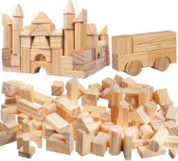



Nested if Statements
Concept
Nested if statements allow you to check multiple conditions in a hierarchical manner. An if statement can contain another if statement within its code block.
Example
This example uses nested if statements to determine whether a number is positive, negative, or zero.
Execution
The outer if statement checks if "num" is greater than or equal to 0. If true, the inner if statement checks if "num" is equal to 0.

Slide 5


else-if Ladder
1
Concept
An else-if ladder checks multiple conditions one by one. If the first condition is false, it checks the next, and so on.
2
Structure
An else-if ladder starts with an `if` statement. Then, it has multiple `else if` statements, each with its own condition. If none of the conditions are true, the code in the `else` block runs.
3
Example
This example shows how to give a grade based on student marks using an else-if ladder.

Slide 6

Thank You!
Presented by: Istiak Rahman
Email: istiak.rahman1020@gmail.com
Thank you for your attention! I appreciate your time and interest.
Keep Learning, Keep Growing

